Slide 1

UNIT3: ART OF BUSINESS LETTER WRITING
PREPARED BY:
Ms. Shivani Arora
Assistant Professor
Graphic Era Hill University

Slide 2
JOB APPLICATION AND COVER LETTER…
Tips for Writing a Job Application Letter
Do not copy your resume. A cover letter is a sales pitch. The purpose of this letter is to convince the hiring manager highlighting your relevant experience and abilities. Your application letter should show how exactly your background makes you a good fit for a particular position. In contrast, your resume is a general record of your experience, education, and accomplishments.﻿
Tailor each application letter to the job. Match your qualifications to the job posting by highlighting the skills, experience, and requirements listed in the description.

Slide 3
Be professional. Application letters have a fairly rigid format—as hiring managers read your letter, they will expect to see certain information included in set areas Pay particular attention to the professionalism of your salutation
Carefully proofread. Employers are likely to overlook an application with a lot of errors. Proofread for grammar and spelling errors. Be particularly mindful to spell the letter recipient's name correctly, as well as the company name.
Follow business letter format. Use business letter format when writing your letter. ﻿

Slide 4
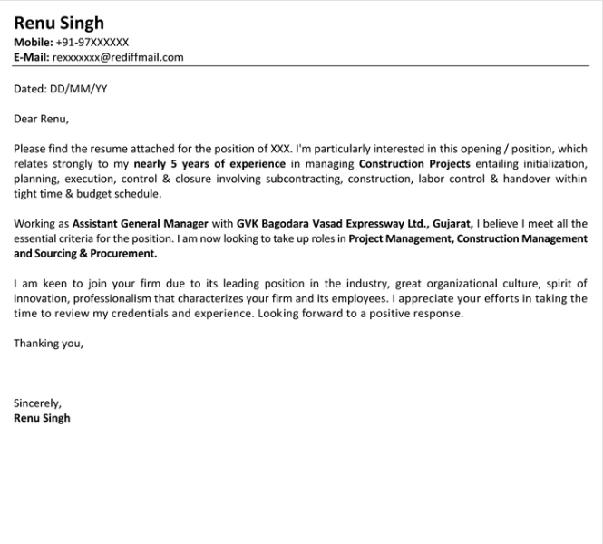
FOR EXAMPLE:

Slide 5
INQUIRY LETTER…
How to Write an Inquiry Letter
Writing a letter of inquiry can become an easy task when you have some guiding material.
An enquiry letter may consist all or few of the below mentioned parts:
Introduction
Description
Statement
Methodology
Final Summary
The inclusion or exclusion of certain components depends on the scope of your letter. Not to forget that these letter are formal letters and will follow the rules pertaining to these.

Slide 6
INQUIRY LETTER FORMAT….
Organisation Letter Head
OR
Your Name
Your Address (can be positioned only to the left)
Date (can be positioned only to the left, before/after or at the start)
Recipient's Name (specific official or person)
Recipient's Address
Reference or Subject (as required)
Dear Recipient (Salutation)
First Paragraph – Details of the Inquiry
Second Paragraph – Brief history, suggestions, statistical data etc.
Third Paragraph – Offer assistance towards communication and assistance

Slide 7
Subscription – Thanking you, yours sincerely etc.
Your Signature
Your Typed First Name Last Name
Your Designation (as required) ENCL (optional) stands for ‘Enclosure’

Slide 8
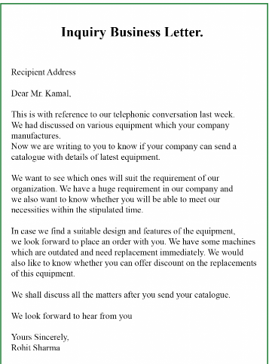
FOR EXAMPLE:

Slide 9
PLACING ORDER LETTER….
The letter should get started with the address of the writer
Then the date should come
After that, the designation as well as the address of the receiver will come
Then the Subject should come, which should be clear and preciseAdd a nice and suitable salutation
Now, start writing the Main body. Make sure that main body is divided into three-four paragraphs. It is important to make the letter presentable.
Para 1- should explain for what are you going to place the order
Para 2– should talk about the details of the services or products that you are placing the order for
Para 3– is going to be the concluding one, so do not forget to mention what do you want in response from the one who is going to receive the order.
End the letter by using the appropriate words to say thanks.
Then sign off with a name

Slide 10
FOR EXAMPLE:
Blossom Public School Ghaziabad February 25, 2020
Sharma and Sharma Group New Delhi
Subject: Purchase of Sports Items
Dear Sir,
It is my pleasure to communicate to you that our school wishes to place an order for sports items in bulk with your company. These items will be used in the activities room, gym, and sports ground of the school starting from the academic session of the year 2020-21. List of the items along with their quantity is given below:
Name of the Items Pieces Needed
Willow bats25
Wicket keeping pads30
Batting pads45
Match ball(red)60
Match ball(white)70

Slide 11
Kindly, deliver the order on time, by ensuring that all the items are taken from the fresh lot. Payment of the entire purchase will be done digitally. It would be great if you could share the time when all the items will be delivered at our address.
Looking forward to hearing from you.
Yours Truly, Ankit Sports In-charge

Slide 12
ACKNOWLEDGEMENT LETTER….
The acknowledgement is also known for acceptance of the truth or recognition of the importance or the expression of gratitude as well. An acknowledgement also is the action of showing that we have noticed or confirming the receipt of something.
An acknowledgement letter, also known as an receipt or a formal written notice of recognition of a fact, a situation, an event that has taken place. This letter written as a polite response to the correspondence and association between you and the recipient.

Slide 13
Date: ________
From,
Mr. _________________ The Director Tiger Welfare Foundation Inc To, Ms. _________________, Address,_____________ Contact Details.________
Subject: Acknowledgement of donation of _______
Dear Abc,
On behalf of ‘Tiger Welfare Foundation Inc.’ I would like to thank you for your generous donation of $15,350/-. I appreciate your concern towards our objective of ensuring the welfare of India’s tigers. Concerned citizens like you help us to bring back the pride of our national animal.

Slide 14
I is proven before by various studies that up until a century ago an estimated 155000 tigers lived in the Indian sub-continent. Today there are fewer than 1,500. Every year ‘Triger Welfare Foundation Inc’ continues its mission of preserving the environment of the Indian tiger, creating awareness about the danger of poaching and smuggling and funding more research to help breed tigers. I can assure you that your gift will go a long way in helping us fulfill our objectives. Thanks again for your crucial contribution.
Best wishes. Signature Name._____________,
Tiger Welfare Foundation Inc

Slide 15
COMPLAINT LETTER…..
Information You May Want to Include:
Store name and location
Your account number
Relevant dates, such as when you bought goods or services and when the problem began
Names of sellers, customer service representatives, or managers with whom you’ve addressed the issue previously
Serial and model numbers
Copies of receipts, invoices, and warranties
Copies of previous correspondence, such as emails, chat logs, or letters
Your contact information

Slide 16
Here’s a sample letter:
555 Five Boulevard Austin, TX 73301
March 20, 2019
Mr. Bob Howard General Manager Products and More 717 Seven Street New York, NY 10012
Dear Mr. Howard:
Re: Account Number 1884434
I am writing to express my dissatisfaction with the Model X tea kettle that I bought on February 28, 2019, at your store located at 1616 Sixteen Avenue. Though the kettle looks fine, it leaks when filled with water. When I attempted to return it to the store on March 2, 2019, the employee on duty, George Burns, told me that he would not accept the item because he didn’t see any damage.

Slide 17
To resolve the issue, I would like you to refund the full amount that I paid ($29.86, including tax) to my Frequent Customer account. I am enclosing a copy of the original receipt.
I look forward to your reply. Please contact me at the address above or by telephone at (555) 555-5555 within the next two weeks.
Sincerely,
Jason Brooks

Slide 18
THANK
YOU!!

